Slide 1
a project by:
PILOT PROJECT
June-August, 2016

Slide 2
INTRODUCTION

Slide 3
In September 2015, all Member States of the United Nations signed the 2030 Agenda for Sustainable Development, a plan of action that seeks to eradicate extreme poverty and ‘leave no one behind’
The plan developed a set a goals and targets - the Sustainable Development Goals (SDGs) - to be achieved by 2030.
The 17 SDGs and their corresponding 169 targets seek to integrate and balance sustainable development: including economic, social and environmental factors.
The Institute for Conscious Global Change (ICGC), a 501 (c)(3) non-profit organization in Special Consultative Status with the Economic and Social Council of the United Nations, works on the “how” to implement these goals, targets and indicators through the Millennium Earth Project (MEP).

Slide 4
The Millennium Earth Project (MEP) lays out a clear plan for “how?” questions surrounding the 2030 Agenda by using the Geographic Information Systems (GIS) and Geodesign technologies.
With GIS and Geodesign technologies we are able to map out data related to the SDGs, making visible the issues and needs of each community, region or country; but also to plan for how to sustainably grow an area to help alleviate the issues that are discovered.
MEP seeks to help governments with the implementation of the 2030 Agenda, providing them the technical support, knowledge and a cost effective method to collect, maintain, and disseminate SDG data to a local as well as global audience.

Slide 5
What is GIS?
Geographic Information Sciences (GIS) is a set of technologies that has the ability to incorporate geographical features with data, and display that information on maps
This method of data visualization makes for a much more digestible and interactive display of data that can be understood visually
Maps show where issues, opportunities, socio-economic data, infrastructure (and many more topics) are physically located, enabling us to see patterns and relationships that would otherwise be difficult to see
Based on the information that the map shows and the analysis of the data collected, the decision-makers (governments, NGOs, private companies, citizens, etc) can ask for and/or implement the necessary actions aimed at solving targeted problems to reach specific goals.

Slide 6
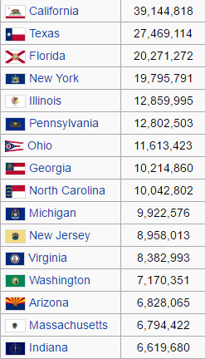
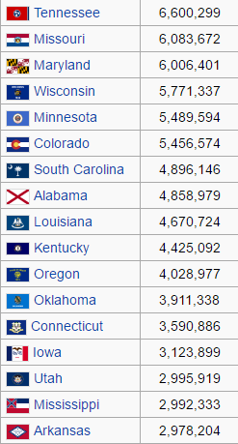
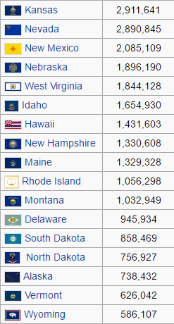
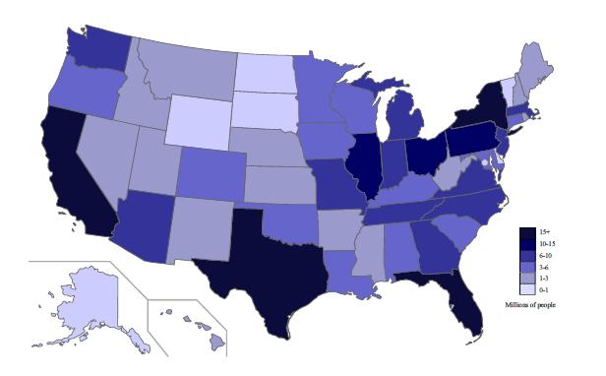
The table on the left shows the population of the US in 2015 by state, the same data is displayed on the map on the right.
It is clear that the map provides a better picture of where population is concentrated in the US.
Source: Wikipedia
https://en.wikipedia.org/wiki/List_of_U.S._states_and_territories_by_population

Slide 7
GIS technology also allows us to store different types of data related to the same geographic features, in different layers.
These layers can include data from socio-economic data, to geographic data, to infrastructural data; and all can be overlain and compared in order to identify patterns and relationships that could not be seen in another medium
By combining these layers on one single map, the system permits a further analysis, e.g. if we map the population density in a state and then overlap the road features, we can asses a road network’s convenience and efficiency in order to create a better system.
By analyzing the resulting patterns we can discern the reasons behind these issues and give recommendations to solve them more effectively
Here is where Geodesign comes in

Slide 8
What is GeoDesign?
Geodesign is a method which has four components: Information Technologies (GIS and others); Design Professionals (planners, architects, etc); Geographic Sciences (ecology, hydrology, etc); and the People of the Place (the citizens!).
It is used to plan and design programs, cities and natural environments with the participation and collaboration of governments, citizens and everyone in between
Given the last given example of a road network: After analyzing the relationship between the road network and the population density, we may realize that the larger cities in an area can be more efficiently linked by a better road network.
Every one of the components comes into play: GIS is used to collect on the ground conditions and data; planners, architects and engineers draw up plans; hydrologists and ecologists use their knowledge and input to improve it; and the whole time the citizenry is engaged with workshops, published data and maps and even some involvement in the collection of photos, data and ideas.
This same approach will be utilized by the Millennium Earth Project to achieve the 2030 Agenda by displaying the data and working towards real world, inclusive solutions to the issues at hand

Slide 9
THE PILOT

Slide 10
Through our pilot project, ICGC had the opportunity to apply the principles of the MEP in a small study area.
The pilot served to inform and resolve the collection, production and analysis that can be done in order to more efficiently achieve the SDGs.
It will also be used as a reference to provide a hands-on experience to ICGC itself, governments, communities and users.
The pilot project was accomplished over 3 months, from June to August 2016.

Slide 11
Geographic Information Systems (GIS) what is it?
STUDY AREA: NEW YORK CITY. QUEENS BOROUGH
The pilot was carried out in the Borough of Queens in New York City.
NYC Boroughs.
Source: NYC OpenData

Slide 12
Geographic Information Systems (GIS) what is it?
GEOGRAPHIC LEVEL: ZIP CODE AREAS
The study area was broken down into ZIP code tabulation areas which were used to display and analyze data at a more targeted level.
Queens Borough. ZIP Code Tabulation Areas
Source: NYC OpenData

Slide 13
CONDUCTING THE PILOT

Slide 14
Geographic Information Systems (GIS) what is it?
1. SELECT THE GOALS AND TARGETS
With a limited time and scope we decided to work on a small snapshot of what MEP can produce.
Therefore, we focused on Goal #1, Target 1.2, and their corresponding indicators.

Slide 15
Geographic Information Systems (GIS) what is it?
2. DATA COLLECTION
The data used for this analysis for the area was gathered from existing datasets including the US Census Bureau, NYC Open Data, and Open Street Map.
Due to time and personnel constraints we were not able to fully implement all aspects of the project.
Going further, we would develop our own geodatabase to collect on-the-ground data that does not exist on the existing databases. This information will be collected by a team of volunteers in the community led by a GIS technician.
This aspect of citizen engagement is essential as it allows the community to be involved in and knowledgeable of the project, meeting one the most important goals of MEP.
Workshops and informative sessions at local community centers and schools will be used to engage citizen volunteers
In these sessions, we hope to teach what data should be captured, provide guidance for entering the data into the system, and explain how the MEP would help to improve their environment.

Slide 16
Geographic Information Systems (GIS) what is it?
3. MAPPING THE DATA AND ANALYZING PATTERNS
With the data gathered from the New York Open Data Portal, we prepared different maps that display the information related to the indicators in the Borough of Queens.
The maps helped us to analyze the resulting patterns and allowed us to have a better understanding of the real poverty situation in the different areas.
This analysis allowed us to give recommendations, which can be targeted to areas most in need and that can help to alleviate poverty in Queens in an efficient way.

Slide 17
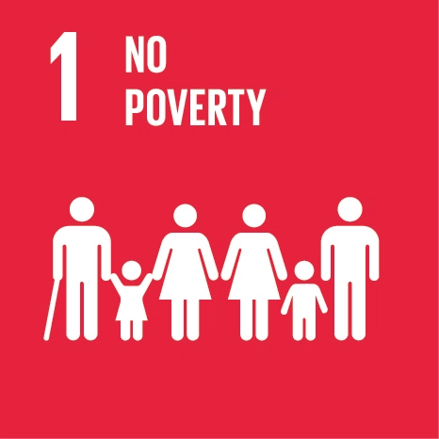
GOAL 1. TARGET 1.2 INDICATORS 1.2.1, 1.2.2

Slide 18
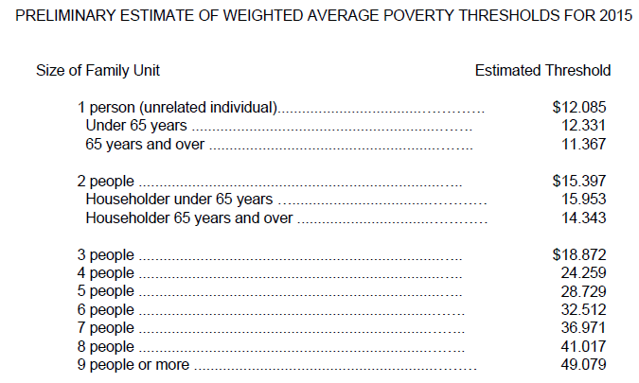
Definition of the national poverty line:
The US Census Bureau gives a poverty threshold for the US population. These values represent the minimum annual income levels that qualifies a family as being impoverished. These values are calculated depending on the size of family, number of children, as well as the age of the members.
Source: U.S. Census Bureau http://www.census.gov/data/tables/time-series/demo/income-poverty/historical-poverty-thresholds.html

Slide 19
Based on the global indicators we are depicting, we mapped and analyzed:
Population below the US poverty threshold
Male vs Female population below the US poverty threshold
Children below the US poverty threshold
Elderly population below the US poverty threshold

Slide 20
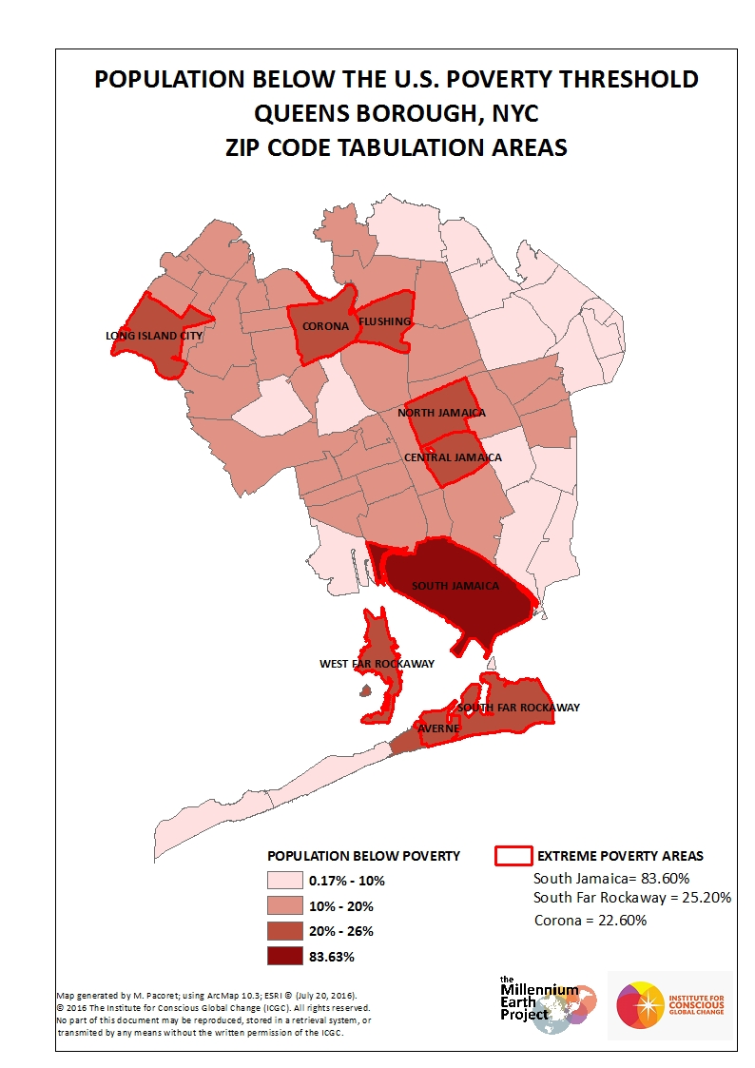
what is it?
POVERTY THRESHOLD. MAP 1
From the data taken by the US Census Bureau, we found out that, in the Borough of Queens, 12.95% of the population is living below the poverty threshold.
This map represents the percentage of people that are below the poverty threshold, classified by ZIP code areas.
This helped us to identify the poorest areas in the borough (bordered in red).
We focused on the three areas with the highest poverty rates: South Jamaica, South Far Rockaway, and Corona.
Most of the remaining areas have between 10-20% of the population living below the poverty line.
Source: U.S. Census Bureau.
POVERTY STATUS IN THE PAST 12 MONTHS 2010-2014 American Community Survey 5-Year Estimates. Table S1701

Slide 21
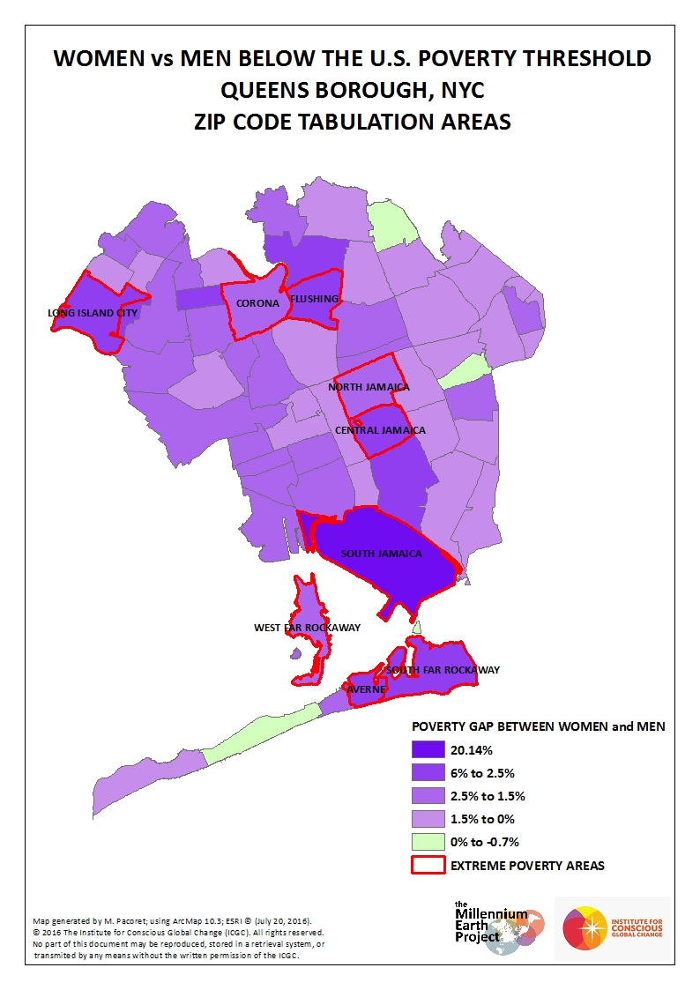
what is it?
POVERTY AND WOMEN. MAP 2
Looking separately into how poverty affects women, we also used the US Census Bureau data. According to the data, the average percentage of women in poverty in Queens, is 15.6% while for men it is 12.8% (about 2.8% less).
When we mapped the data in the different ZIP code areas classified by gender, the resulting maps revealed that, as expected, the zones with the highest levels of poverty either for women or men were the same as identified before on the last map.
However, comparing how poverty affects women in contrast to men, we observed that the poverty rates for women were higher in almost all areas and between 4 to 8 points higher in the rates for men.
There were only three areas -the ones in green- in which the poverty rate for men was higher than for women, and only by a difference of less than 1 point.

Slide 22
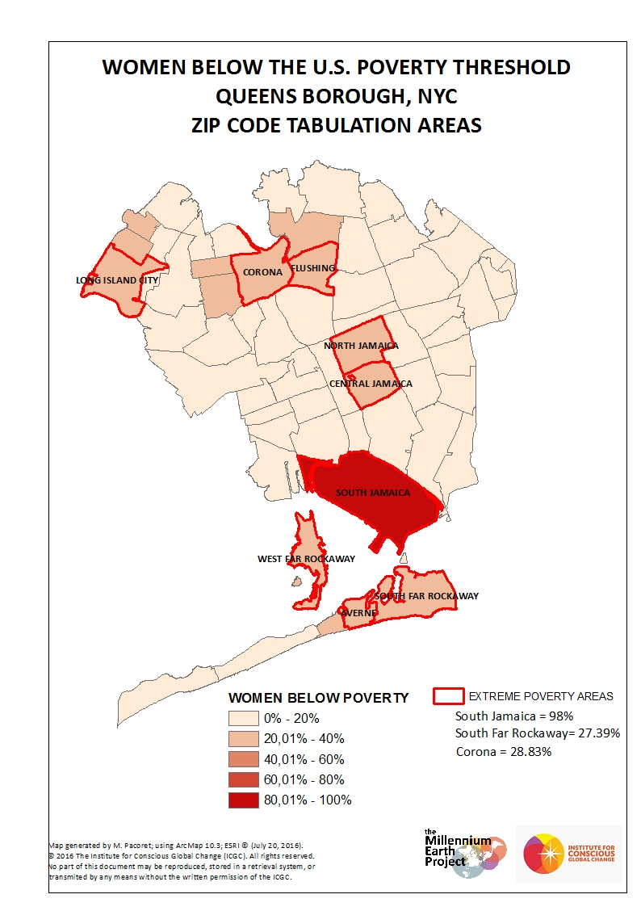
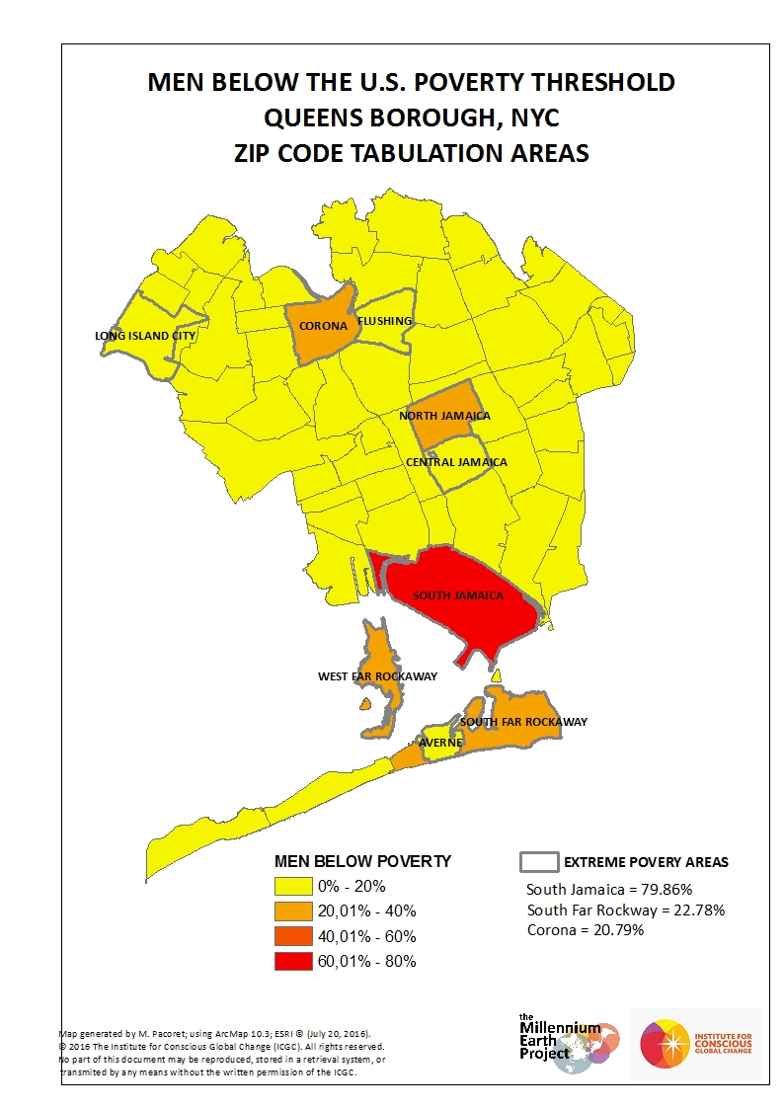
MAP 2
Source: U.S. Census Bureau.
POVERTY STATUS IN THE PAST 12 MONTHS 2010-2014 American Community Survey 5-Year Estimates. Table S1701

Slide 23
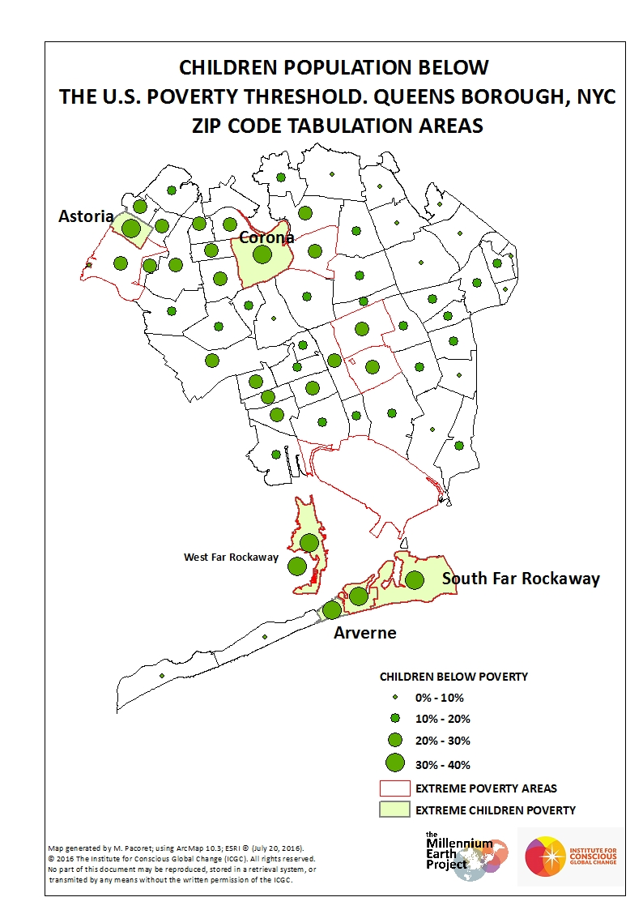
POVERTY AND CHILDREN. MAP 3.1
According to the US Census Bureau data, 17.62% of children in Queens live in poverty. This is 4.5 points above the average for the total population.
This map shows the ZIP code areas in the Borough of Queens classified according to the percentage of children in poverty.
The areas colored in green are those with the highest levels of children in poverty, about 35% of children live in poverty.
The area in Corona deserves special mention because it has the highest percentage of the population in poverty, both generally and among children.
Source: U.S. Census Bureau.
POVERTY STATUS IN THE PAST 12 MONTHS 2010-2014 American Community Survey 5-Year Estimates. Table S1701

Slide 24
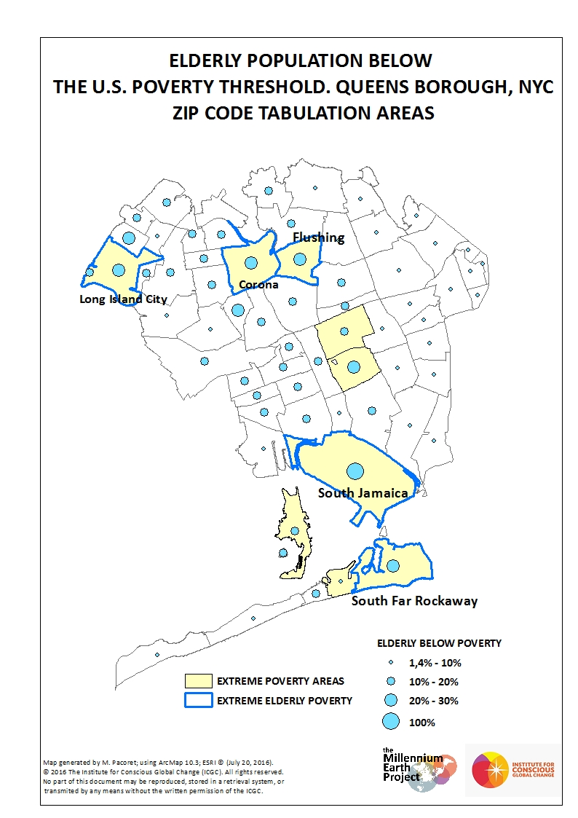
POVERTY & THE ELDERLY. MAP 3.2
The elderly are another vulnerable group in terms of poverty. Elderly here is defined as people over 65 years of age.
According to the US Census Bureau data, 13.29% of the elderly in Queens are living below poverty and only 0.34% above the average for the total population.
The areas bordered in blue are those with the highest levels of elderly in poverty. There are about 25% of the elderly population living in poverty.
The areas in Corona, Jamaica and Far Rockaway, deserved a special mention because they have the highest percentage of the population in poverty, both generally and among the elderly.
The areas in Long Island City and Flushing were revealed as zones where elderly poverty is also quite high.
Source: U.S. Census Bureau.
POVERTY STATUS IN THE PAST 12 MONTHS 2010-2014 American Community Survey 5-Year Estimates. Table S1701

Slide 25
FURTHER ANALYSIS

Slide 26
ICGC believes that poverty is a much more complex issue with many influencing factors. Therefore, the MEP pilot has extended the data analysis to the relationship between poverty and:
ethnicity/race
unemployment rates
employed people that are still in poverty
education attainment
education facilities

Slide 27
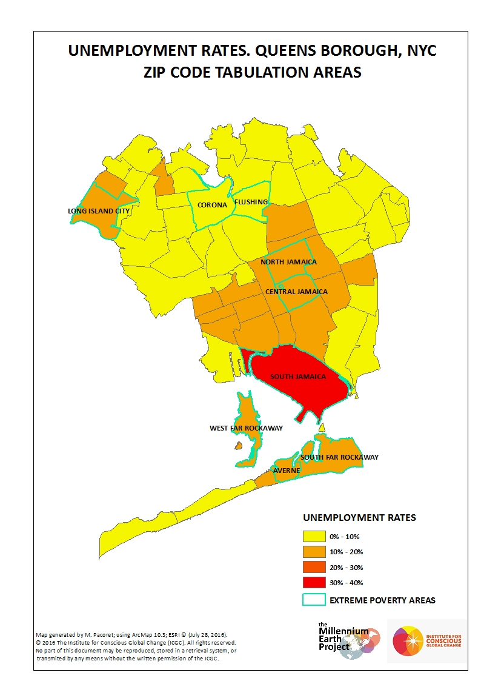
POVERTY AND UNEMPLOYMENT. MAP 5.1
It is reasonable to assume that unemployment rates would be higher in areas with more people living in poverty. Therefore, we studied the unemployment rates in relation to extreme poverty areas.
Using the US Census Bureau data, we depicted the ZIP Codes in Queens classified by unemployment rates. Areas with extreme poverty levels are highlighted in green.
As expected, the area in Jamaica (ZIP Code 11430) revealed not only the highest percentage of people in poverty, but also the highest levels of unemployment.
However, areas in Corona and Flushing had the lowest unemployment rates while the percentages of population in poverty were within the highest.
Source: U.S. Census Bureau.
EMPLOYMENT STATUS. 2010-2014 American Community Survey 5-Year Estimates. Table S2301

Slide 28
POVERTY AND RACE
According to the US Census Bureau data for Queens, the percentage of the population that were living below the poverty threshold by race/ethnicity were:
15.29% for African American
14.20% for Asian
15.20% for Hispanic
10.75% for Whites
Recalling that the average percentage of population in Queens below the poverty line is 12.95%, we found out that Whites were the only racial demographic with poverty rates lower than the average.
When we depicted the ZIP Code areas in the Borough of Queens where the percentage of African Americans in poverty were higher than this average, it resulted in 36 zones. In the case of Asian, Hispanic, and White populations the number decreased to 33, 30 and 16 areas, respectively.

Slide 29
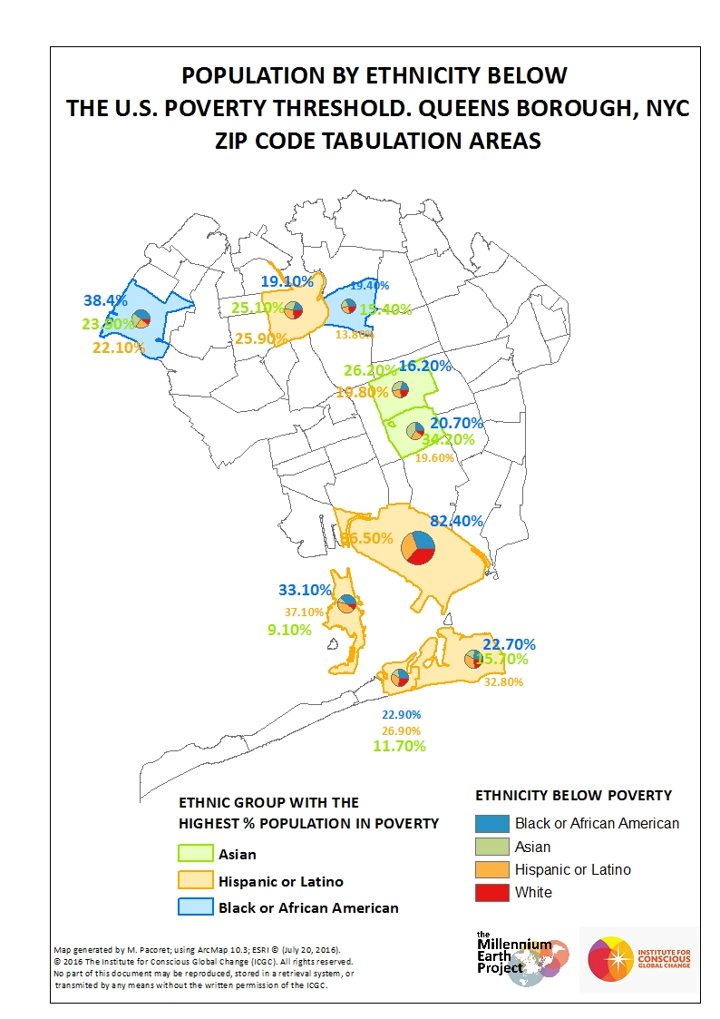
MAP 4
The zones colored on the map represent the 9 ZIP Code areas with the highest percentage of the population in poverty in Queens, classified by ethnicity.
The color in each area represents the ethnic group with the highest percentage of the population in poverty in this area.
There is not a homogenous pattern that could describe the distribution of poverty among different ethnicities though as you can see Hispanics have the highest poverty rate in 5 of the 9 areas depicted.
Source: U.S. Census Bureau.
POVERTY STATUS IN THE PAST 12 MONTHS 2010-2014 American Community Survey 5-Year Estimates. Table S1701

Slide 30
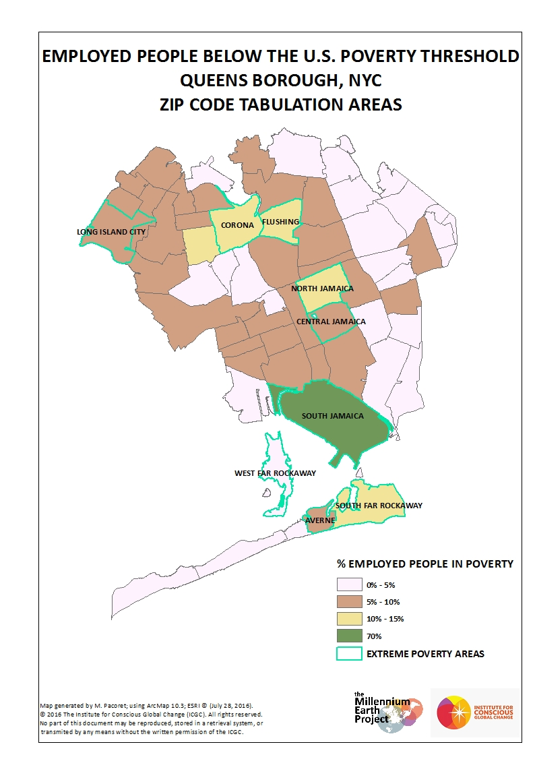
POVERTY WITHIN EMPLOYED. MAP 5.2
This map shows the percentage of employed people that were still in poverty in the ZIP Code areas in Queens, according to the US Census Bureau Data. The areas with the highest percentage of population in poverty are highlighted in green.
As with the other analyses the Jamaica represents the highest levels of poverty among the employed.
All the areas with percentages between 10% and 15% of employed people in poverty are colored in yellow, 4 of which are within the higest areas of poverty
Areas between 5-10% employment in poverty are in light brown, only 3 of which are within the highest poverty areas
Source: U.S. Census Bureau.
POVERTY STATUS IN THE PAST 12 MONTHS 2010-2014 American Community Survey 5-Year Estimates. Table S1701

Slide 31
POVERTY AND EDUCATION
In addition, we studied the location of the school facilities in the area and their relationship to the children population density.
According to Census Bureau for educational attainment in Queens, the data is as follows:
21.40% for people with Less than High School Degrees
14.60% for High School Graduates
10.20% for those with some College Education
7.75% for those who have a Bachelor’s Degree or Higher
From these results, it was observed that:
The greater the educational attainment, the lower the percentage of people in poverty. This trend was also present in all the ZIP Code areas under study.
The population whose education attainment was high school or less was more affected by poverty. The percentages were between 1.5 to 8.5 percentage points above the average for Queens (12.95%). However, the poverty rate for those who had attended university was below the average.

Slide 32
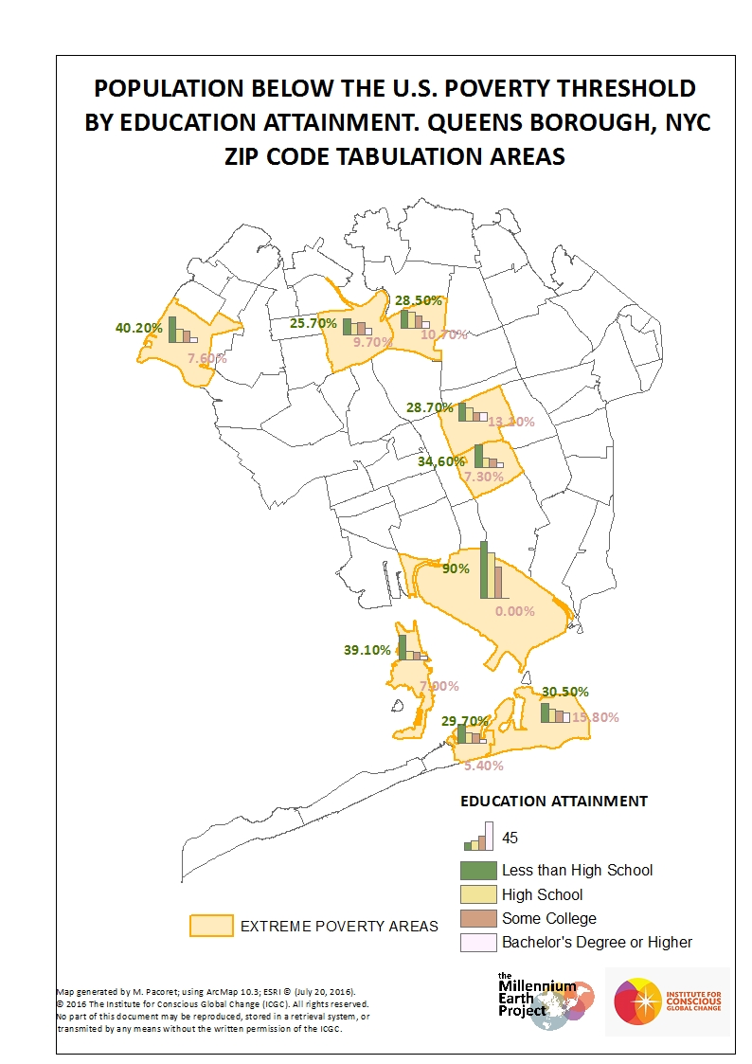
MAP 6.1. EDUCATION ATTAINMENT
This map shows the 9 ZIP Code areas with the highest percentage of poverty in Queens classified by education attainment. The percentages displayed on the map corresponded to the people with lowest and highest education attainment .
The percentage of people in poverty with the highest level of education was above the average in Queens in two areas: Corona and Far Rockaway.
In all areas people in poverty with the lowest education attainment had a much higher poverty rate than the average in Queens.
Source: U.S. Census Bureau.
POVERTY STATUS IN THE PAST 12 MONTHS 2010-2014 American Community Survey 5-Year Estimates. Table S1701

Slide 33
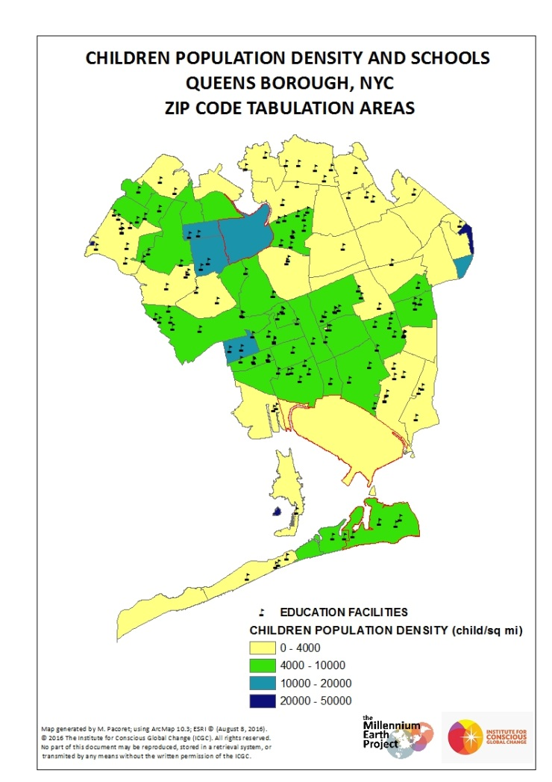
MAP 6.2. EDUCATIONAL FACILITIES
This map shows the location of the schools facilities in Queens that overlap with population density of children by square mile in all ZIP Code areas.
With the resulting pattern, it was important to highlight that there were no schools in the north central area of Corona while the child population density there was one of the highest. In addition, as we found out from the previous analysis, children living in poverty in this area was at one of the highest rates.
In the rest of the borough the distribution of the schools generally fit the child population density.
Sources: U.S. Census Bureau. SEX BY AGE 2010-2014 American Community Survey 5-Year Estimates. Table B01001
Open Street Map. NYC Buildings Files

Slide 34
OUTCOMES

Slide 35
Considering the patterns revealed by the maps, we concluded that:
South Far Rockaway, South Jamaica and Corona were also locations with serious poverty problems, for all the studied groups.
In regards to women, it would be necessary to take further actions, since the gap between men and women raised a weighted average of nearly 12%. This difference was especially alarming in South Jamaica, though Corona, Arverne and Long Island City are also worrisome.
Focusing on children, it could be said that, Queens needs special measures for this age group. The percentages of children in poverty is quite high, in general. Areas in the South, like Arverne and Far Rockaway, and Corona and Astoria in the North, were the most affected by poverty.

Slide 36
In the case of the poverty within the elderly population, the resulting pattern was pretty similar to poverty in the general population. However, Flushing popped up as a location where the rates were among the highest.
From an ethnicity perspective, as expected, special measures for minorities groups would be necessary in all the areas in Queens. Whereas areas in Far Rockaway and South Jamaica would require more attention to Hispanics, Long Island City would need to focus on the African Americans.
An interesting and surprising result was yielded from the analysis of the unemployment rates in Queens. Since unemployment is directly related to poverty, the map revealed that all the Central and Southern areas in Queens were reported to have the highest levels of unemployment (around 25%). However, these locations were not the most affected by poverty.
As the maps show, the education attainment was directly linked to poverty; the lower the levels of education of the population, the poorer the citizens.

Slide 37
RECOMMENDATIONS FOR WHAT CAN BE DONE TO REDUCE POVERTY IN QUEENS

Slide 38
In regard to women, special measures to help this group such as tax benefits, encouraging workforce participation, or paid maternity leave can help alleviate the disparities. All of these measures will allow women to have easier access to the job market and targeted services and policies.
In order to address poverty among children and the elderly, targeted expansion of food assistance programs, new and expanded schools, and health benefits could all have an a positive effect.
For the areas where ethnic minorities are seriously affected by poverty, local governments might create programs to promote the workforce diversity such ensuring the participation and representation of all minorities in the public employment recruitment.
Considering that there are some areas where many employed people are still in poverty, local governments might implement measures to help families with additional incomes and subsidized housing.

Slide 39
On the basis of greater educational attainment to achieve lower poverty, local governments should promote programs to upgrade worker skills and help them to find more qualified jobs with higher wages.
In parallel, we recommend the construction of new schools in the area in Corona because here, the children population density is within the highest and there are no schools.
Finally, it is important to highlight that in the areas where special programs are set up, the change in rates over time should be studied in order measure their effectiveness.

Slide 40
Thank You!
visit us at www.consciousglobalchange.org
email us at info@consciousglobalchange.org
tweet us @consciousglobal and follow us on facebook!

